Slide 1


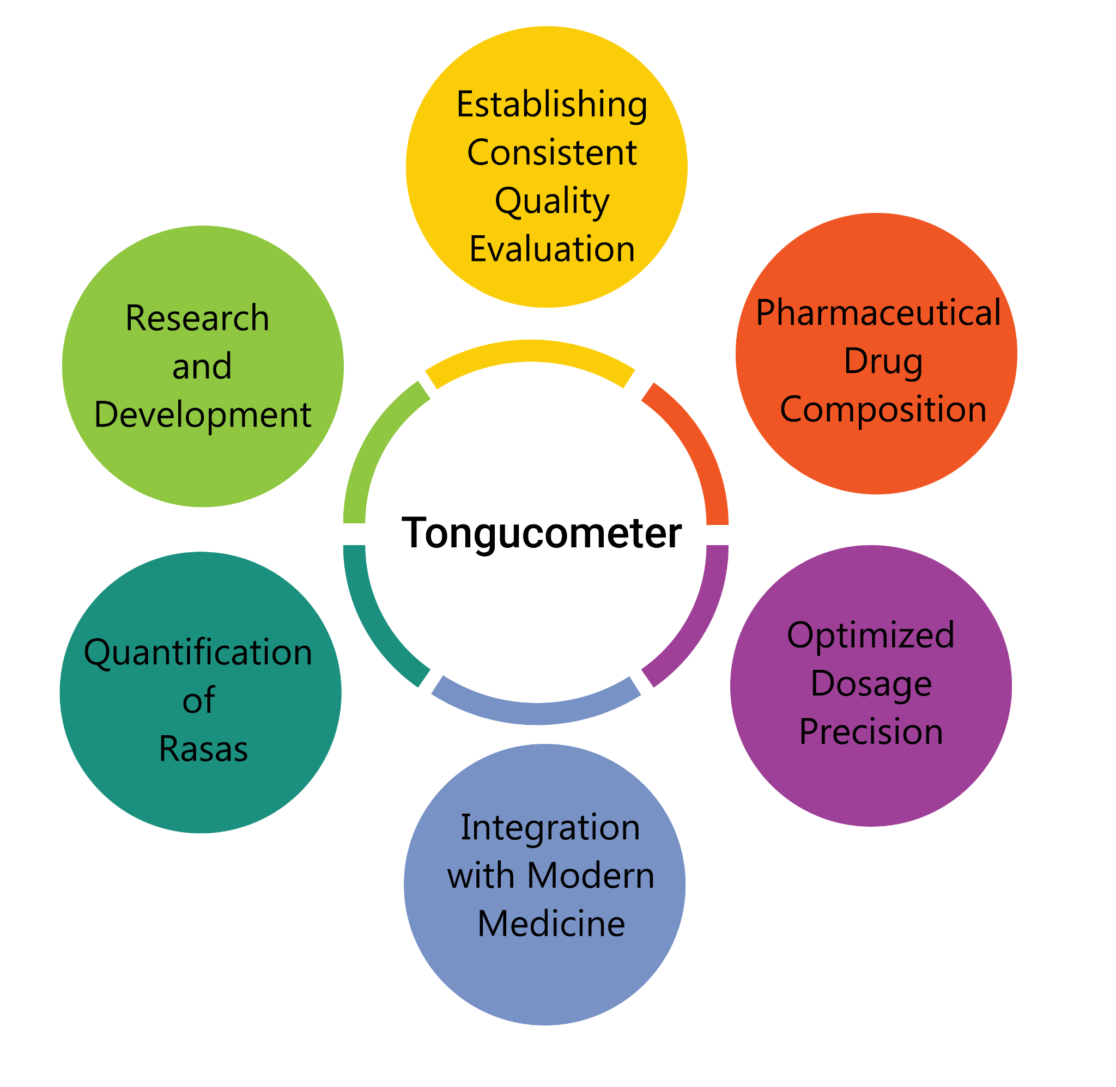
Team Details and Problem Statementl
Ministry/Organisation Name:- Ministry of Ayush
PS Number:- SIH1342
Problem Statement Title:- Development of a prototype instrument (sensor based) for assessment and quantification of rasas (taste) in crude herbs.
Team Name:- Maverick 2.0 Team Leader Name:- Shivika Tyagi
Institute Code:- C-46109 Institute Name:- AJAY KUMAR GARG ENGINEERING COLLEGE
Idea Aiml
Standardized Quality Assessment: The Tongucometer would provide a standardized method for assessing the taste profile of herbs and dietary items, ensuring consistent quality and effectiveness in Ayurvedic treatments.
Medicine Formulation: Ayurvedic practitioners could use the device to precisely formulate herbal medicines, ensuring the correct balance of tastes for specific health conditions.
Improved Herbal Product Quality: Manufacturers can use this device to maintain the quality and authenticity of their herbal products, reducing variability in taste profiles.
Research and Development: The Tongucometer can aid in research on Ayurvedic herbs, helping to identify their therapeutic potential based on taste characteristics.
Optimized Dosage: The device can help determine the appropriate dosage of herbs and dietary items, reducing the risk of overuse or underuse.
Health Management: Ayurvedic practitioners and individuals can better manage health conditions by selecting foods and herbs with the right taste attributes to balance their doshas (Vata, Pitta, Kapha).
Solution Approachl
Sweetness :- because of the presence of glucose in it which we will detect with help of DF Robot Gravity Glucose sensor.
Sourness :- because of the presence of Citric Acid which we will detect with help of pH Sensor whose pH is between 3-6.
Pungent:- because of the presence of a compound Allyl isothiocyanate (AITC) which we will detect with help of VOC Gas Sensor.
Bitterness :- because of the presence of Ca ions in substances which can be detected with the help of Ca Ion Selective Electrode
Astringent :- because of the presence of tannins in substances which can be detected with the help of Ca Ion Selective Electrode

Slide 2
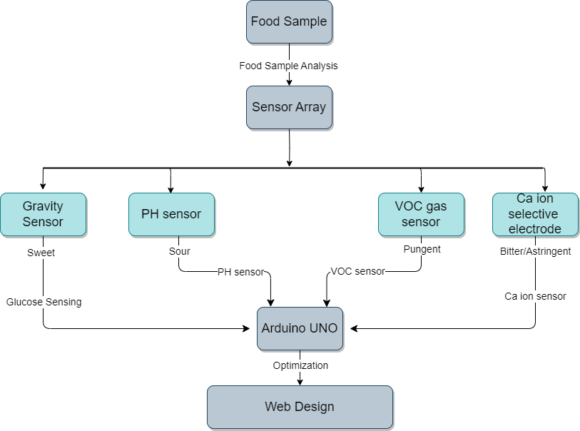
Data Flow Diagraml
Workingl
For working of this artificial tongue, the whole process that will be followed is explained below :-
Sample Preparation
The initial step demands the herb/food sample in liquid form.
If it is not in liquid form, firstly we have to convert it into liquid form by powdering it and then mixing with water (since mixing water with most of the herbs does not change their chemical propositions).
Sample Placement
This herb sample will be placed on a sample tray which will be connected through a sensor array.
Sensor Functionality
Now sensors array that is connected with sample tray is responsible for assessing various taste attributes, including sweetness, pungency, bitterness, and astringency.
Gravity Sensor: This sensor is dedicated to detecting sweetness.
pH Sensor: It is employed to measure the sourness of the sample.
VOC Gas Sensor: This component is responsible for quantifying the pungent qualities of the sample.
Ca Ion Selective Electrode: This specialized electrode plays a crucial role in evaluating both bitterness and astringency.
Data Collection, Analysis and Display
Then all this sensor data will be received and collected by arduino UNO which will send the data to the computer.
The computer undertakes a comprehensive analysis of the received data and optimize it for clarity and precision. Following this analysis, the refined data is presented on the computer screen for the user's perusal.

Slide 3
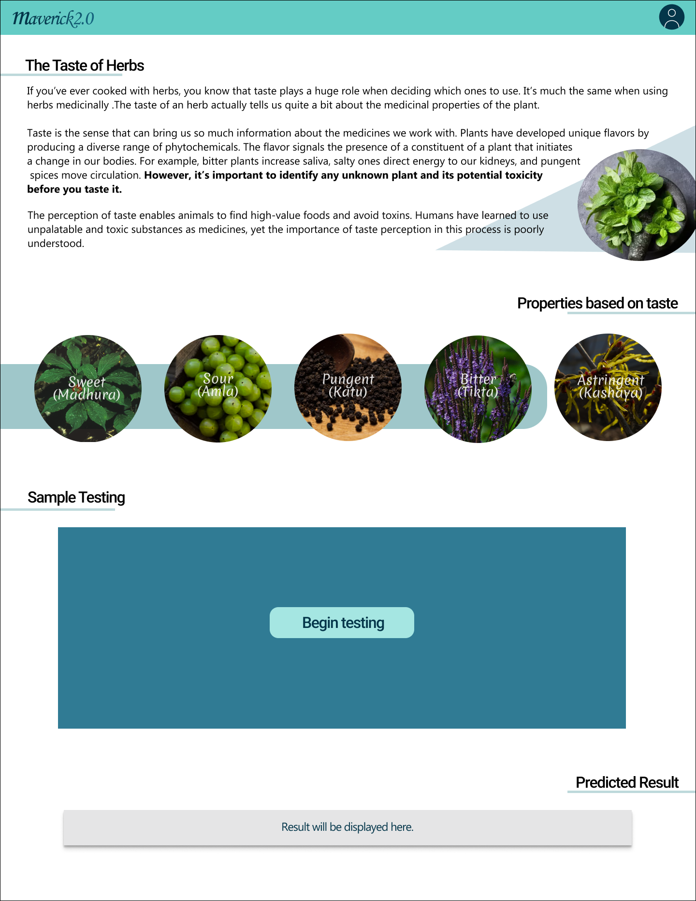
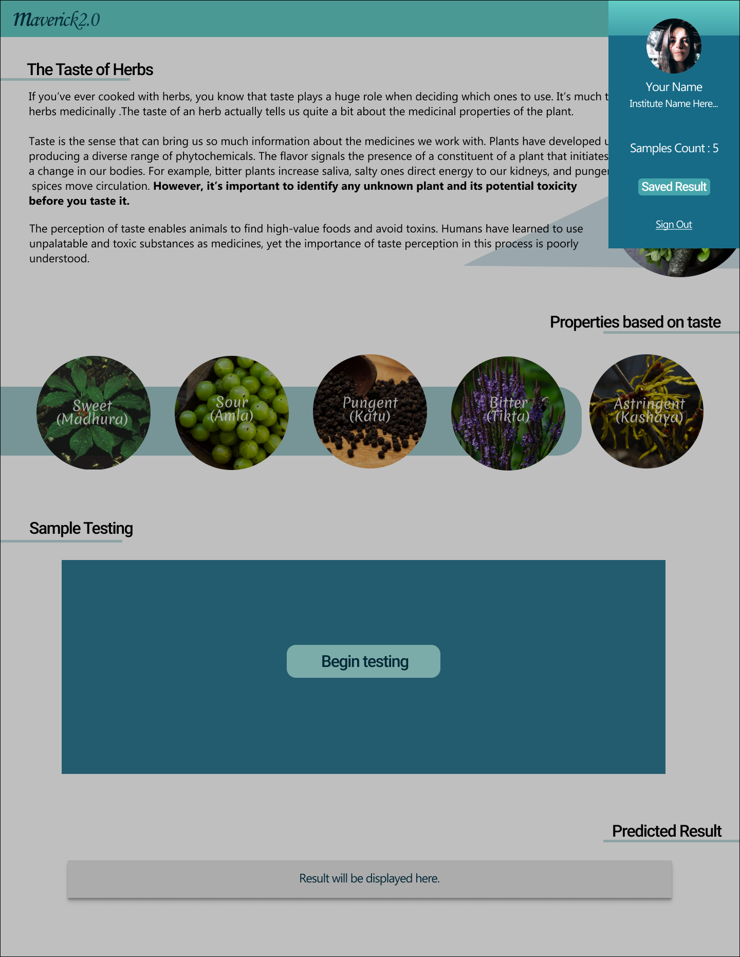
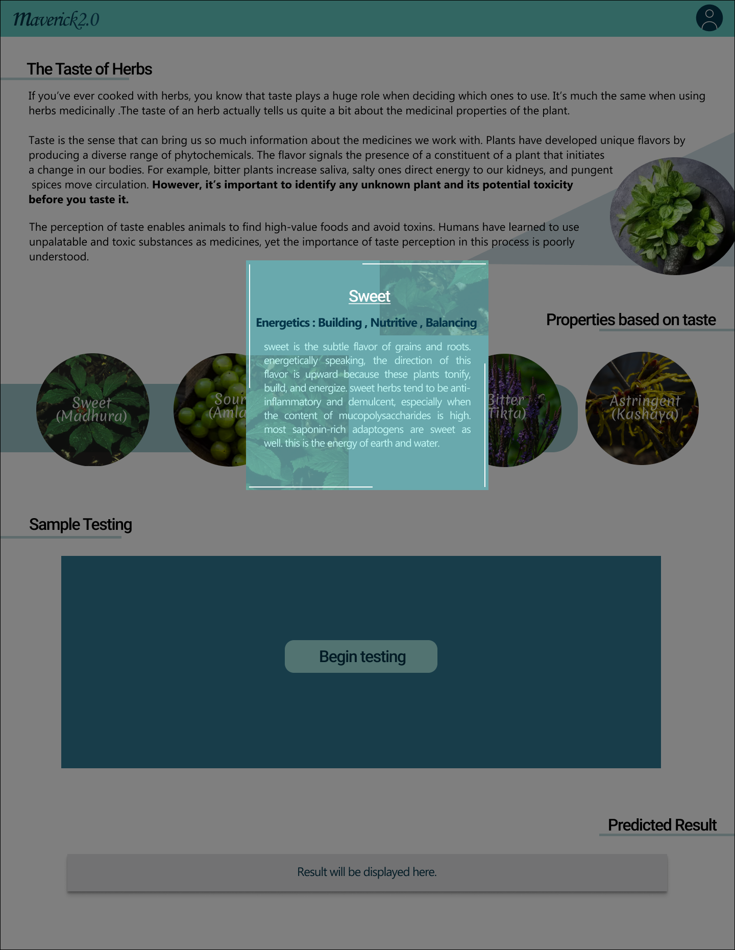
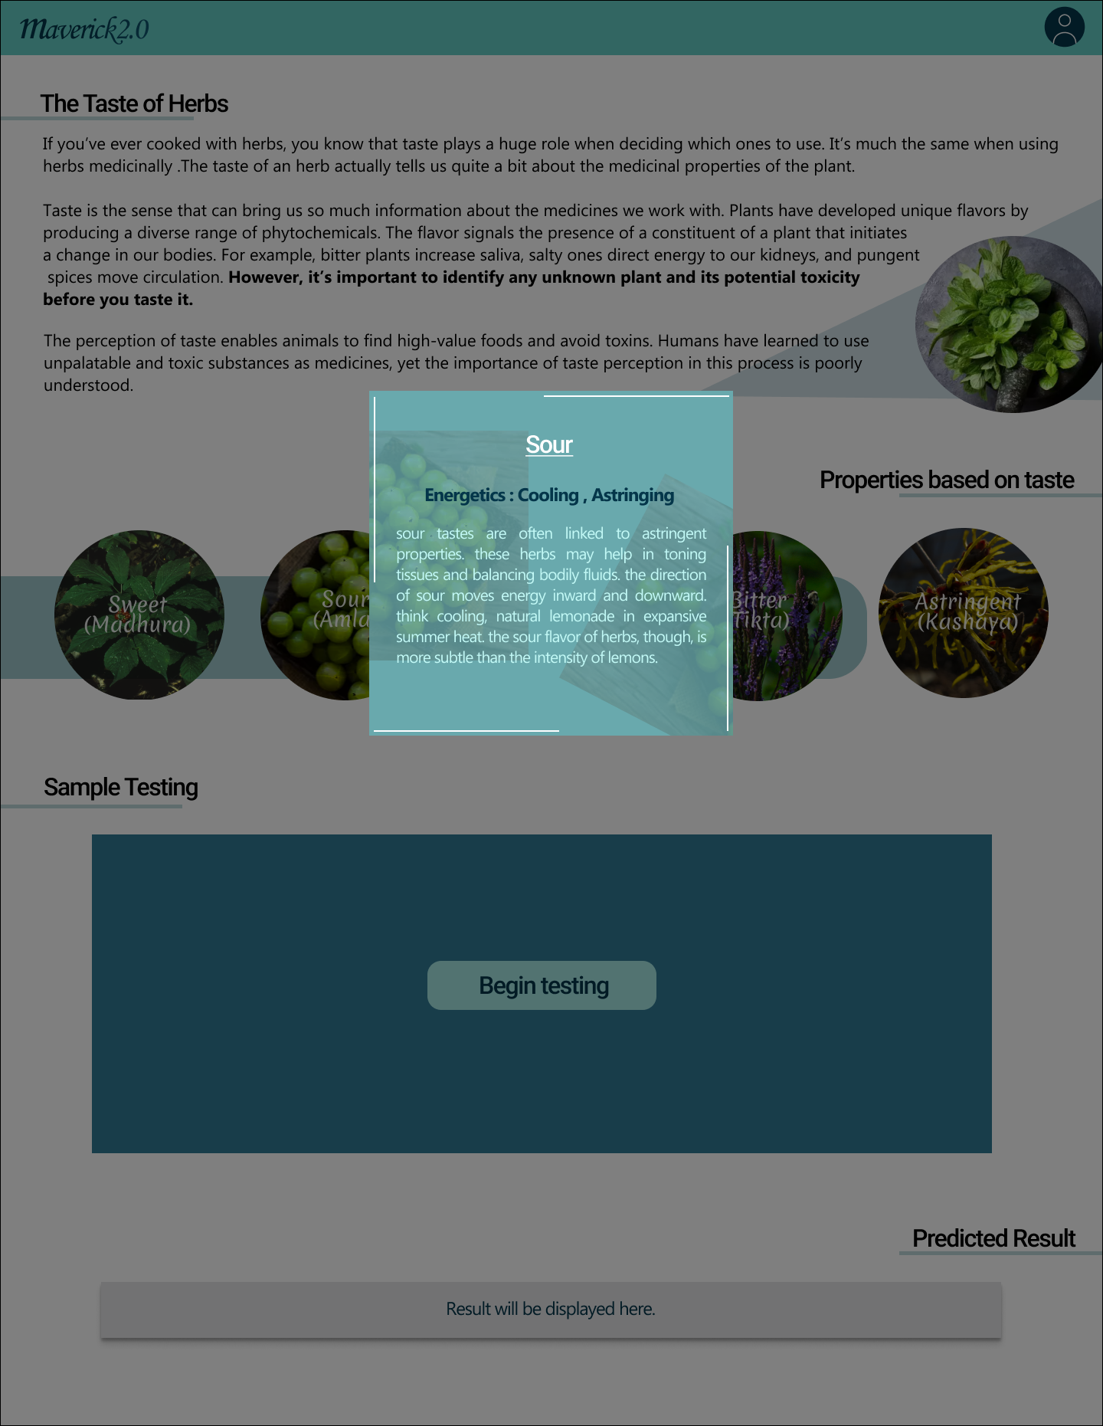
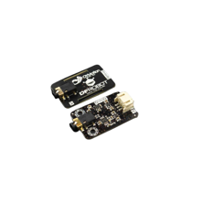
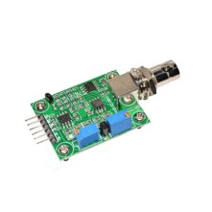
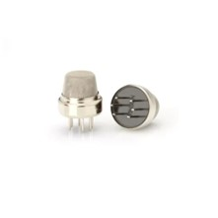
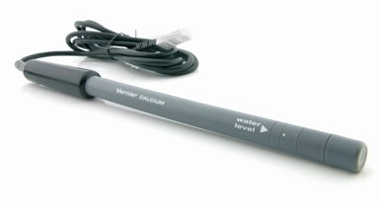
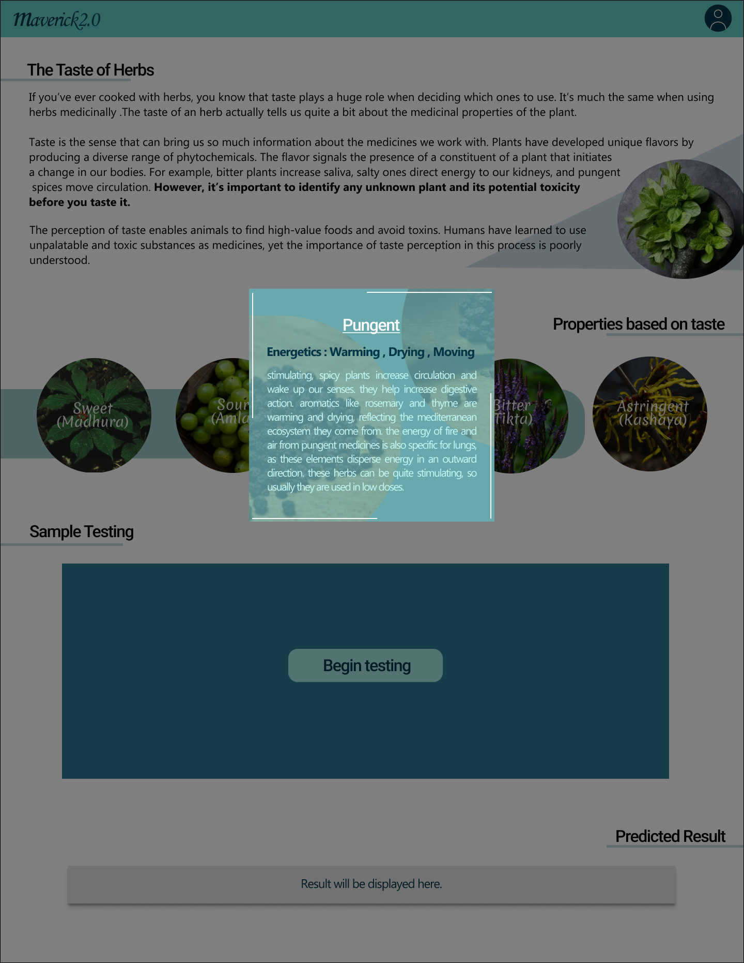

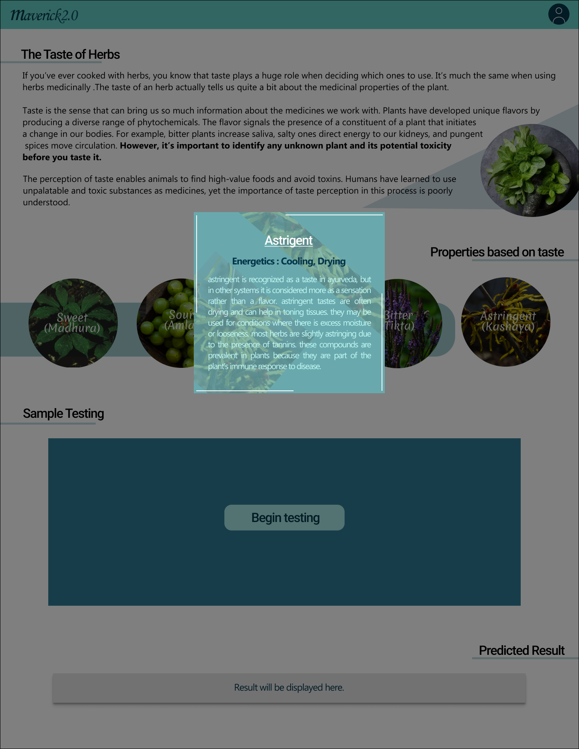
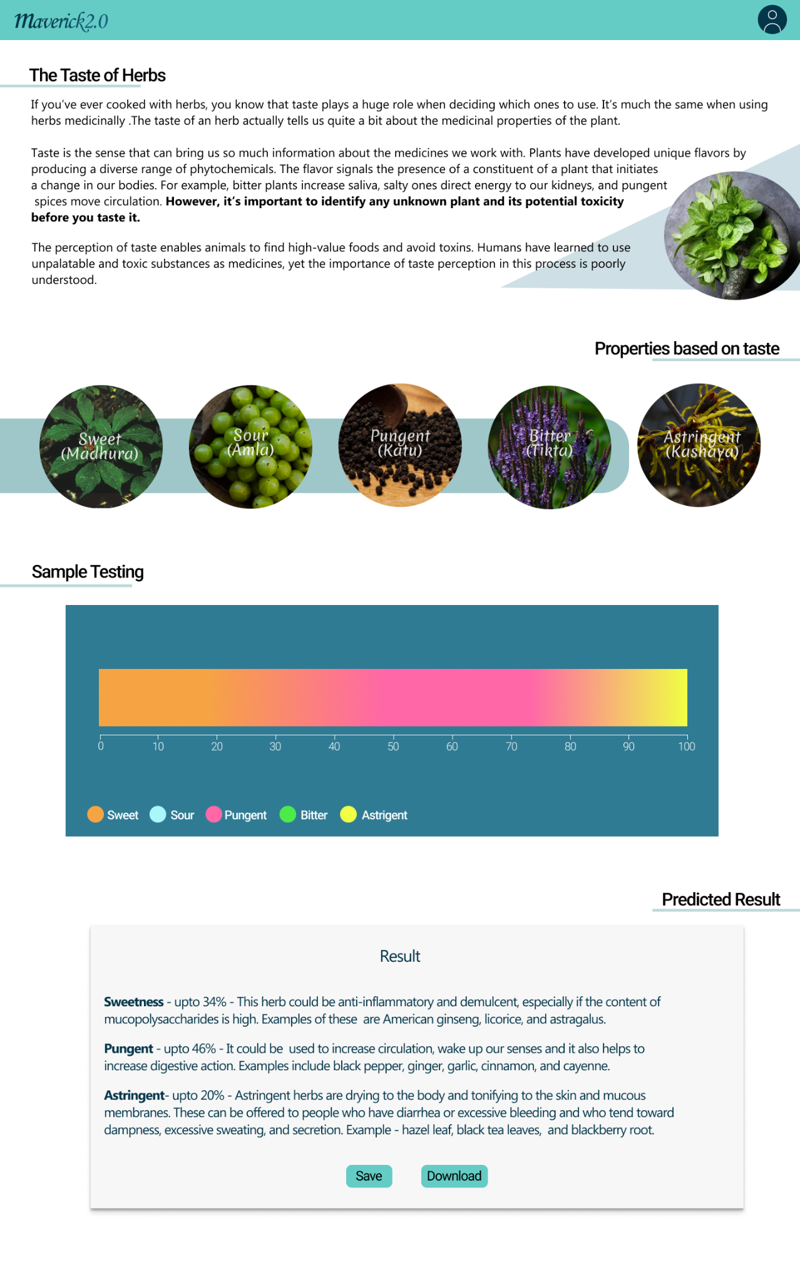

Sensors/Devices Usedl
Layoutl
DF Robot Gravity Glucose Sensor
pH Sensor
VOC Gas Sensor
Ca Ion Selective Electrode
Arduino UNO

Slide 4
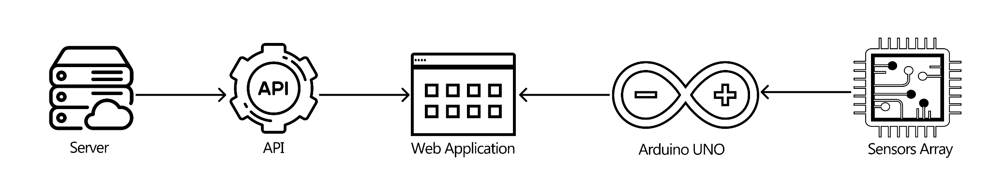
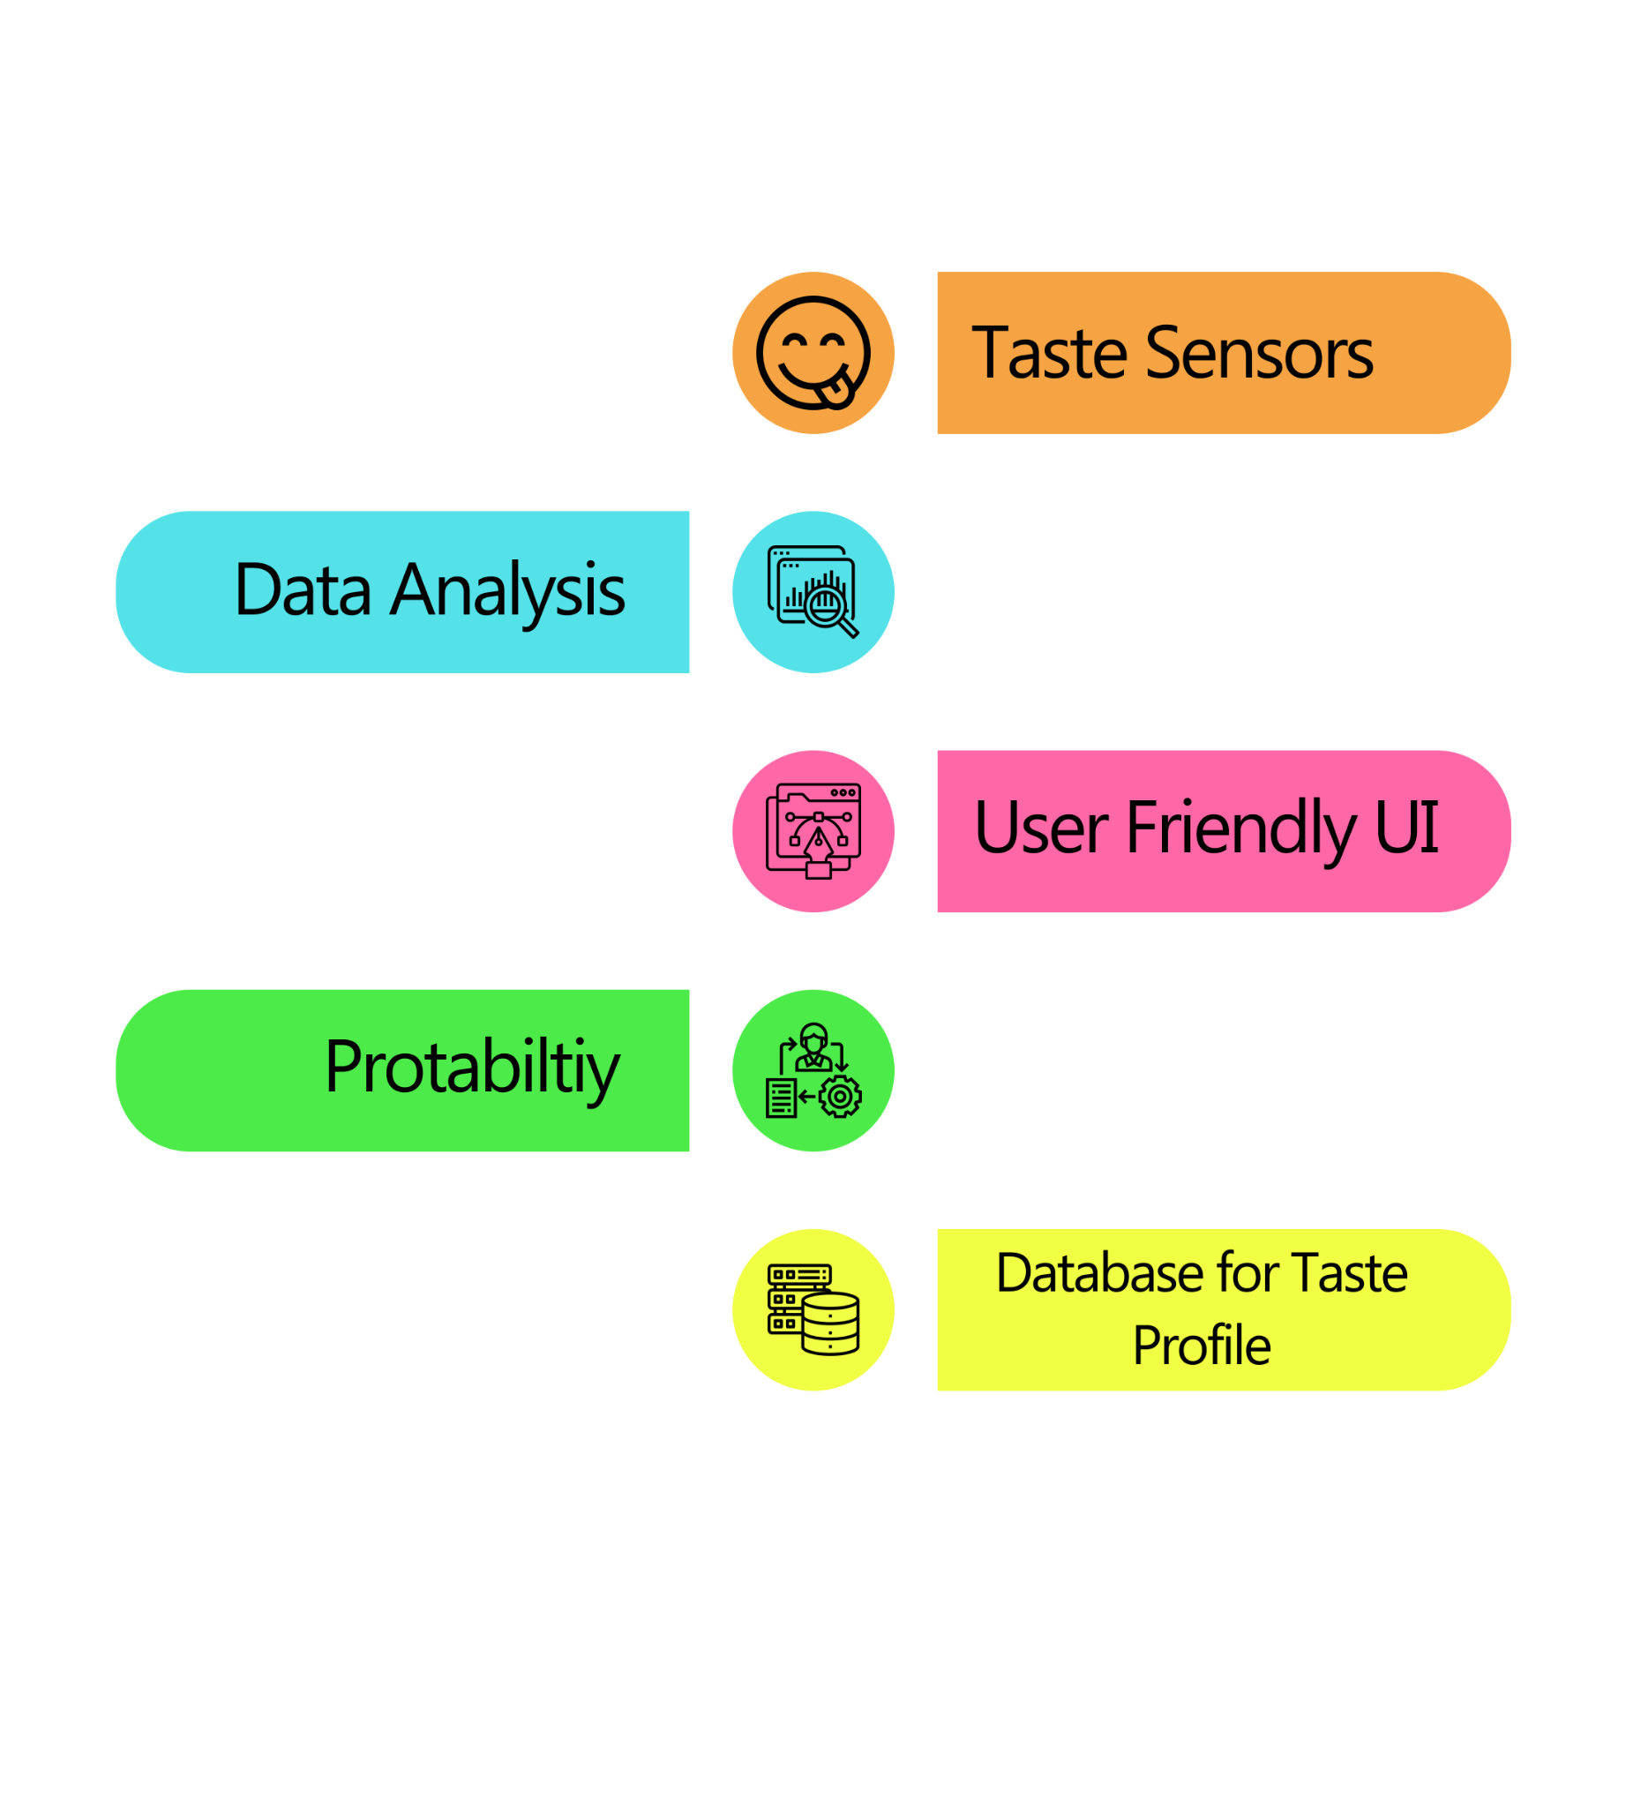
Technology Usedl
Prototype Links:-l
UI Prototype :- http://bit.ly/prototypee-link
Explanation link of Prototype :- https://bit.ly/3shGohV
Featuresl
Future Upgradationl
Herbal Medicine Research: The device could be used to further research the relationship between taste and medicinal properties of herbs, helping to identify new herbal treatments based on their taste profiles.
Quality Control in Herbal Products: It can expand its use in the herbal product industry by becoming a standard tool for quality control, ensuring consumers receive authentic and effective Ayurvedic products.
Telemedicine Integration: With advancements in telemedicine, the Tongucometer could be integrated into telehealth platforms, allowing Ayurvedic practitioners to assess taste preferences remotely and provide personalized recommendations.
Ayurveda Education: It can be incorporated into Ayurvedic education programs to train future practitioners in assessing and formulating Ayurvedic treatments.
Team Leader
Name: SHIVIKA TYAGI
Branch: Btech Stream: CS Year: IV
Team Member 1
Name: Paras Agarwal
Branch: Btech Stream: CS Year: IV
Team Member 2
Name: Samiksha Khandelwal
Branch: Btech Stream: CSE AI/ML Year: IV
Team Member 3
Name:Swati Agarwal
Branch: Btech Stream:CS Year: IV
Team Member 4
Name: Deeksha Jindal
Branch: Btech Stream:IT Year: IV
Team Member 5
Name: Abhishek Raj
Branch: Btech Stream:CSE Year: IV
Team Mentor
Name: Mrs Ritu Sharma
Category:Academic
Expertise: Software Engineering
Domain Experience: 9+ Years

